Slide 1
19CSE211 COMPUTER ARCHITECTURE & ORGANIZATION
Single Cycle Implementation of MIPS Architecture

Slide 2
Data Path design for SCI but what is Data Path?
A Data Path element is a Unit(hardware component), which helps in holding the data.
The data could have been the one which is going to be processed or already processed.
In the either cases above, data requires a place to stay and that is meant by a data path element.
Data path Elements- Memory elements to hold instructions, Memory elements to hold data ,ALU , Registers, Buses, Adders, Multiplexors etc.

Slide 3
Data path Elements in the MIPS Implementation-Combinational and Sequential
Two different types:
elements that operate on data values.
elements that contain state.
The elements that operate on data values are all Combinational elements-ALU
The elements that contain state or some internal storage are all State elements-Instruction memory, Data memory, Registers

Slide 4
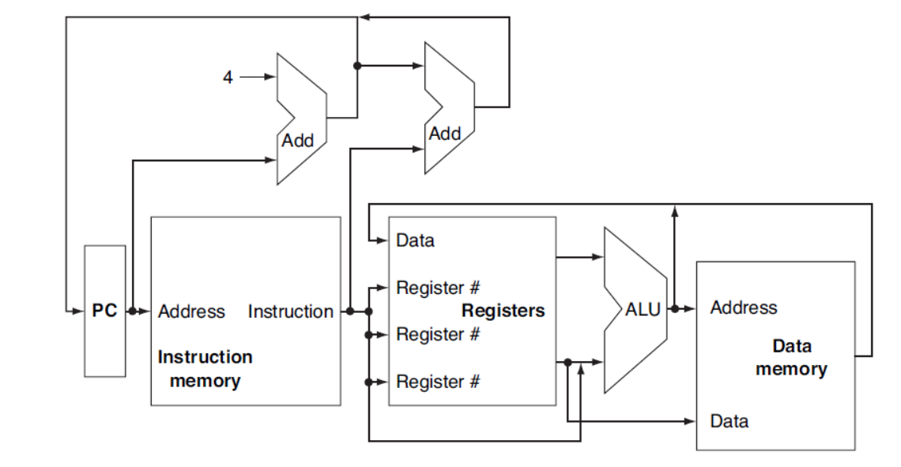
Abstract View of the Implementation of the MIPS

Slide 5
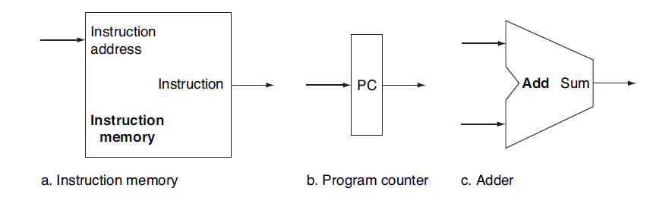
Building a DataPath

Slide 6
Data Path Portion for fetching instructions and incrementing the Program Counter

Slide 7
Register File and ALU-For R format Instructions

Slide 8
Two Units needed to implement Loads and Stores

Slide 9
Data Path for Branch Instruction

Slide 10
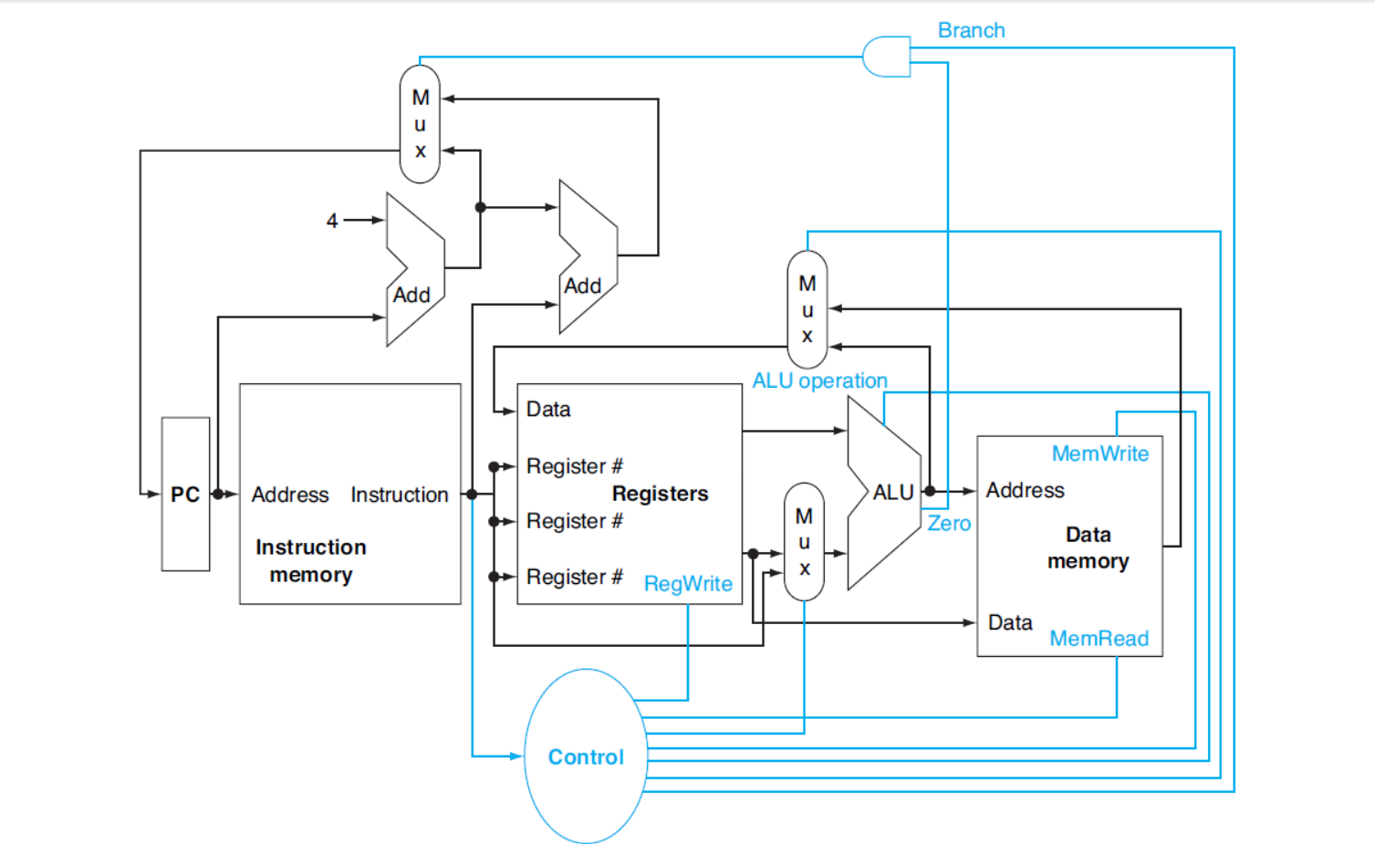
The basic implementation of the MIPS , including the necessary multiplexors and control lines.
Notes:
s

Slide 11
Datapath for lw-sw, ALU Operations and Branches

